Slide 1
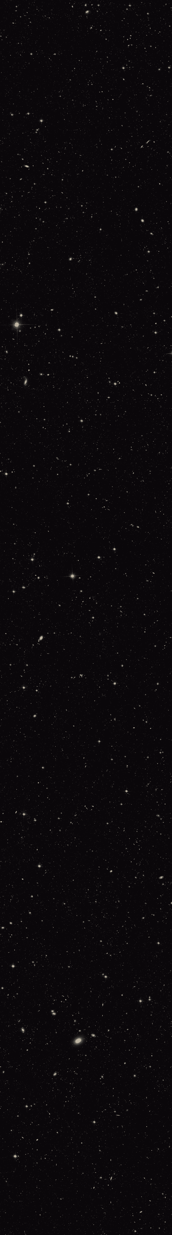
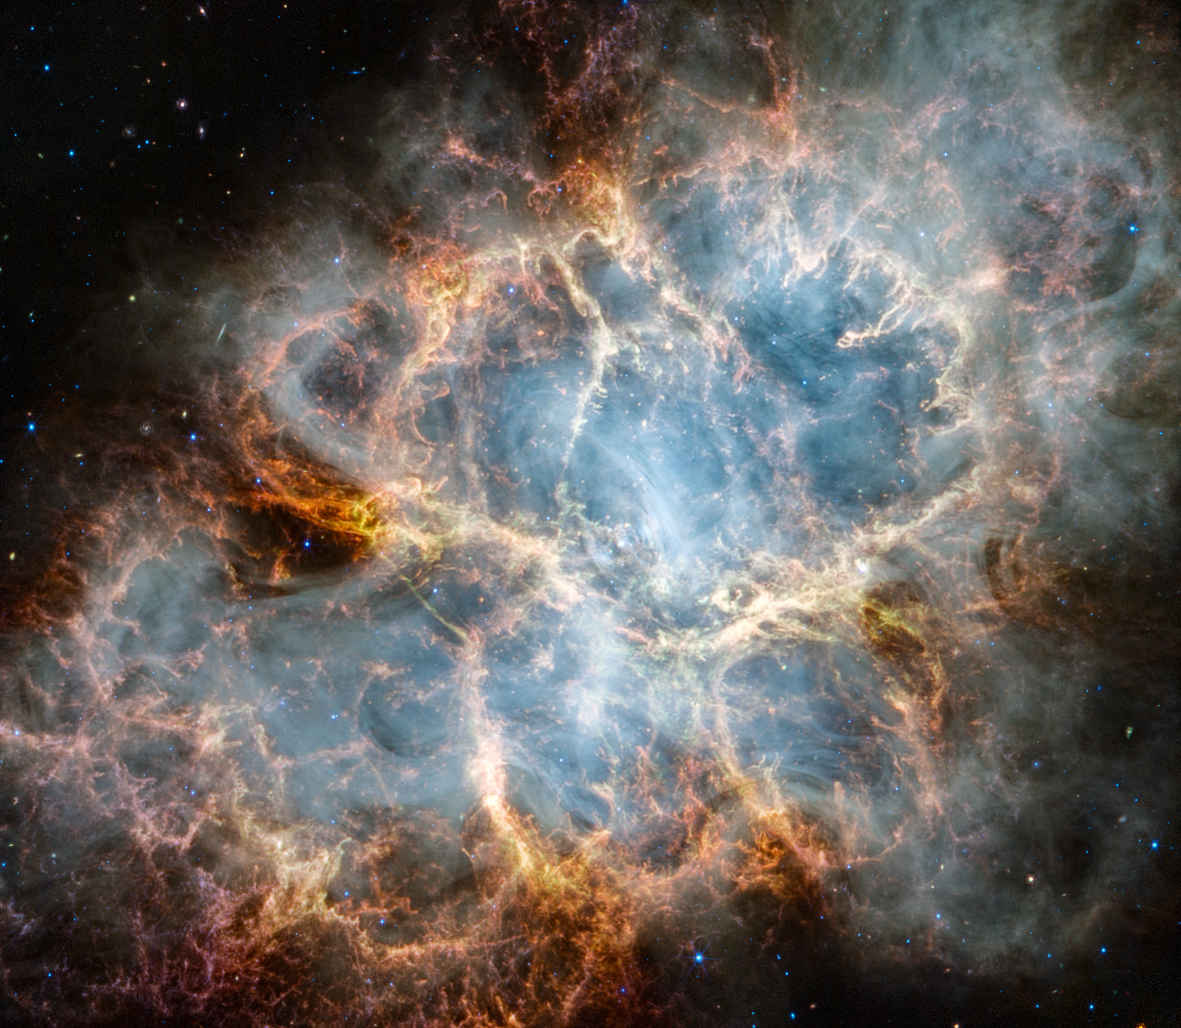

COSMIC CRESCENDO
2024 NASA Space Apps Challenge:
Symphony of the Stars: Harmonizing the James Webb Space Telescope in Music and Images
METU STARGAZERS
Ankara, Türkiye
Team Members:
Mehmet Alp ÖZAYDIN
Hüseyin Umut IŞIK
Zeynep Aslı KASAP
Emir ŞAHİN
Kamil Anıl IŞIK

Slide 2
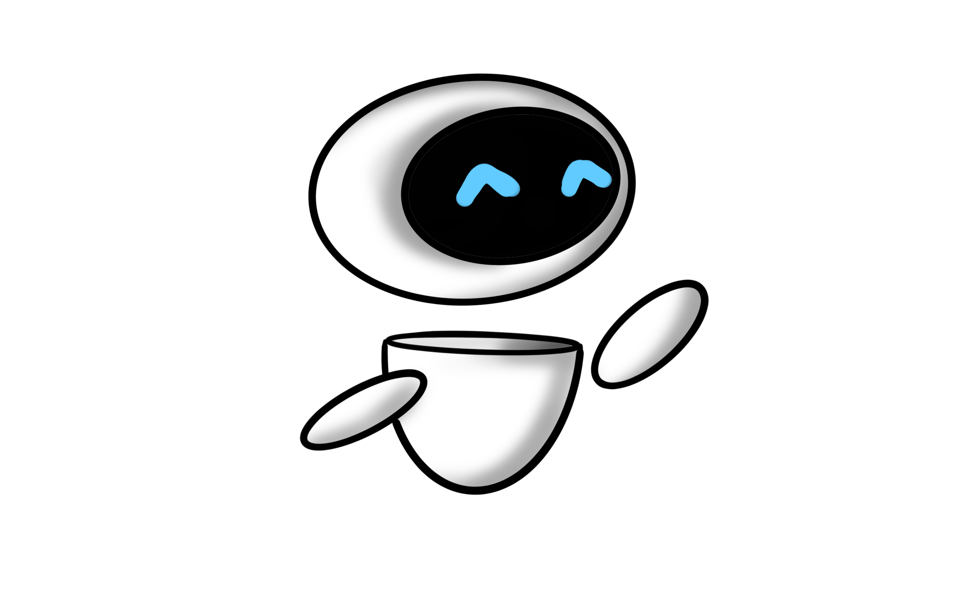
COSMIC CRESCENDO
Main Steps of the Project
Object Detection and Segmentation
Data Sonification
Sound Production and Implementation
Mobile and Web App Development
And loooots of collaboration with fun

Slide 3
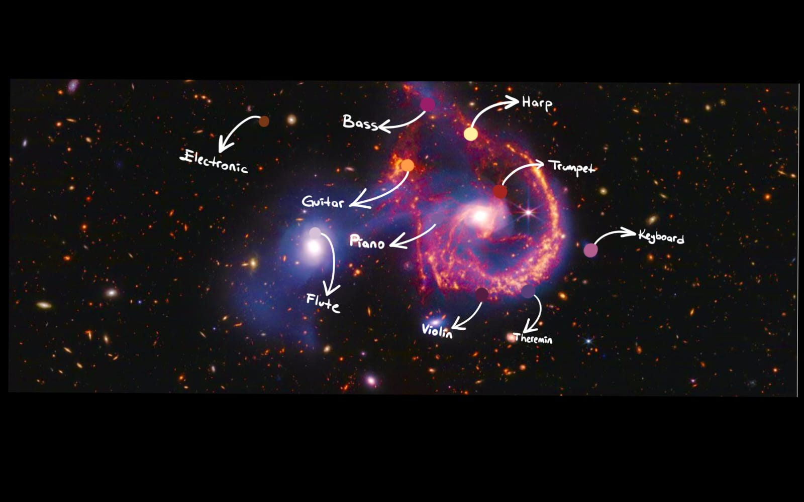
DATA SONIFICATION ALGORITHM
RGB
RGB
Different RGB values
of each pixel
create different sounds
Reflection of space environment by sounds related to colours

Slide 4
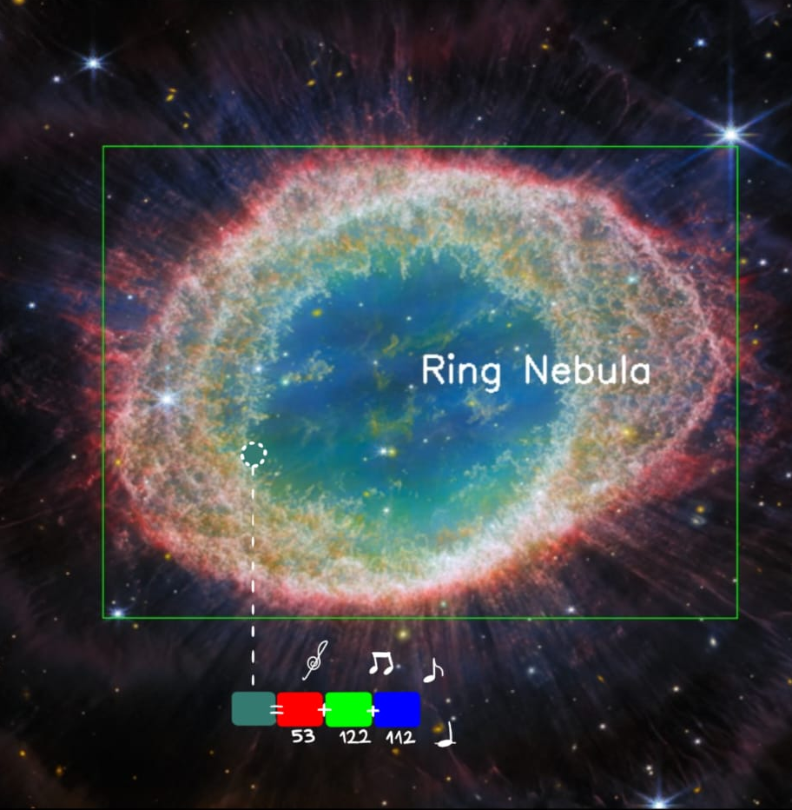
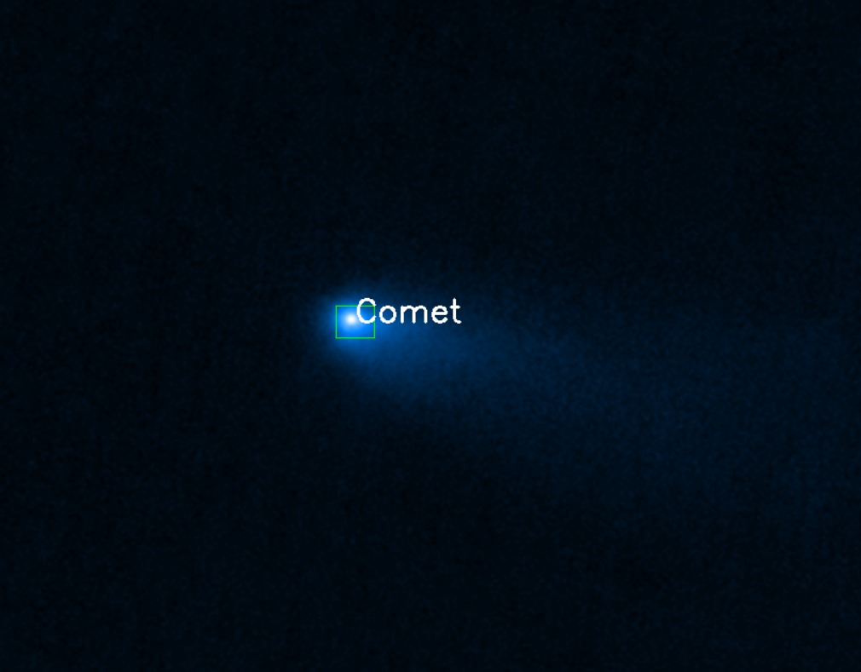
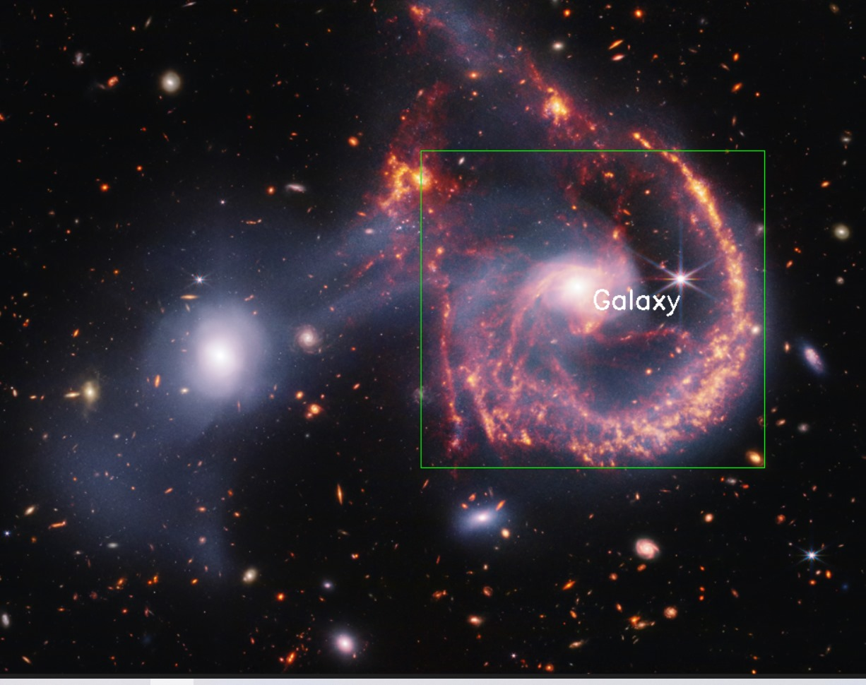
Object Detection Algorithm
Python code to
detect astronomical objects
Playing different instruments
in different objects

Slide 5
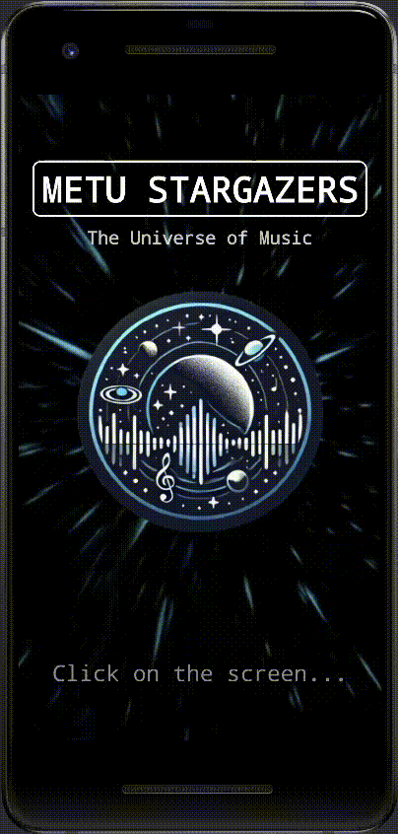
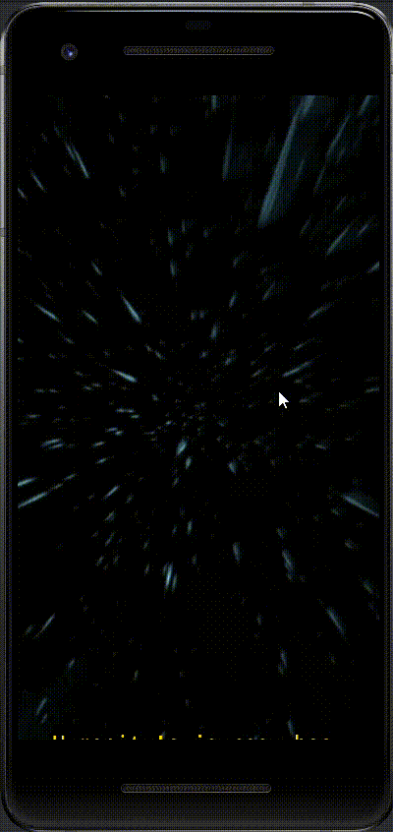
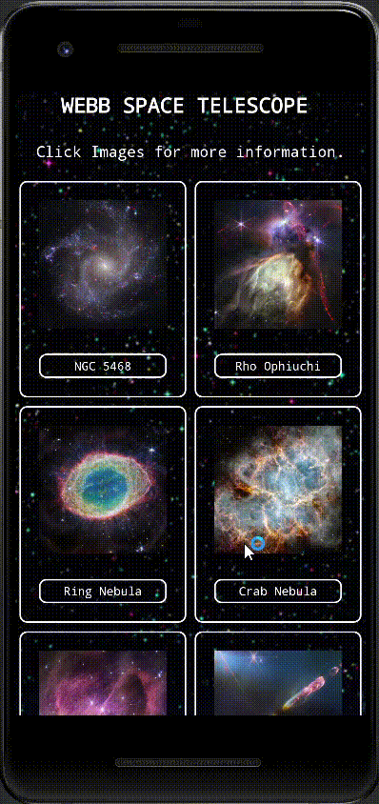
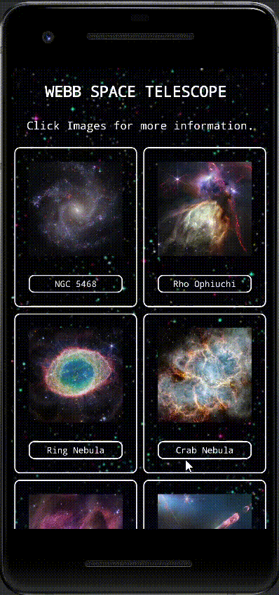
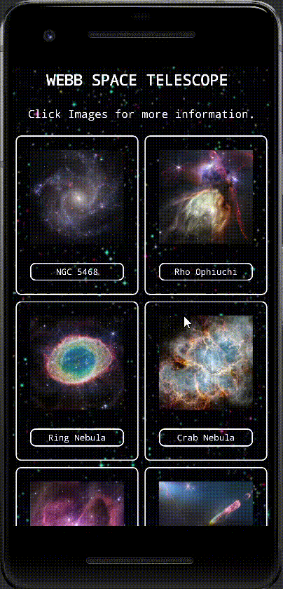
MOBILE APP FOR ALL AGES
Interactive and Educational

Slide 6
COSMIC CRESCENDO WEBSITE
Video Demonstraion of Our Website:
https://youtu.be/xjWlyx8WKLI

Slide 7
Resources
https://webbtelescope.org/home
https://opencv.org
https://developer.android.com
https://science.nasa.gov/mission/hubble/multimedia/sonifications/
https://giphy.com/gifs/loop-tumblr-featured-TZf4ZyXb0lXXi
https://openai.com/chatgpt/

